Slide 1
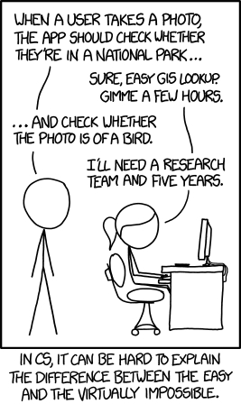
Notes:
Done

Slide 2
CIS 700-004: Lecture 4W
Convolutional Neural Nets
02/06/19
Notes:
Done

Slide 3
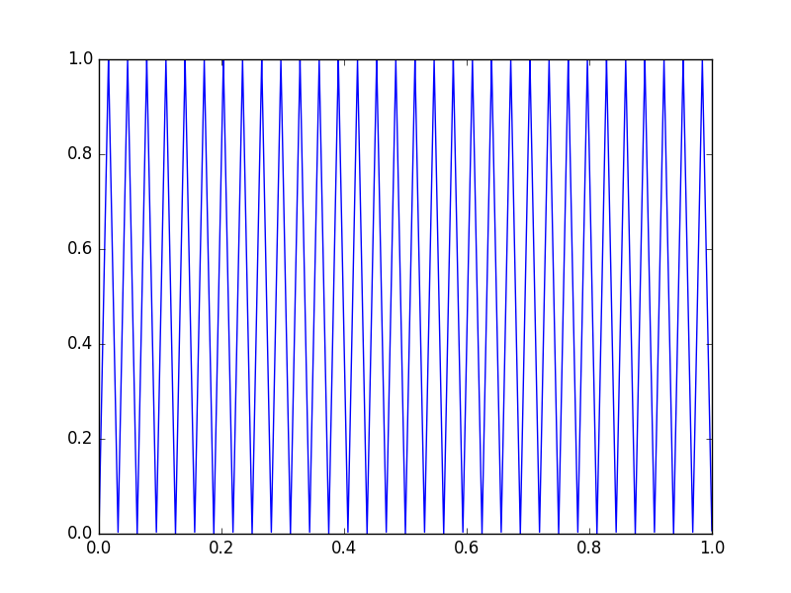
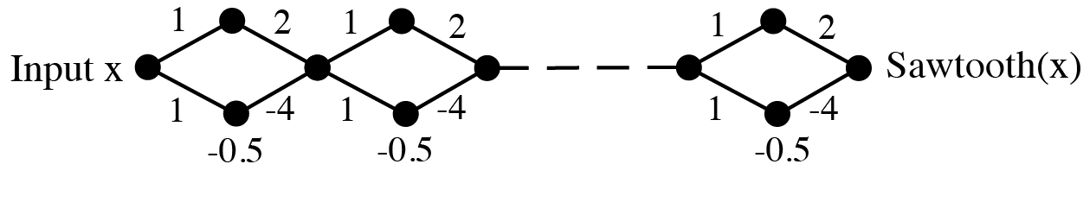
Notes from previous lecture: sawtooth
Sawtooth function
The sawtooth function with 2^{n} pieces can be expressed succinctly with ~3n neurons (Telgarsky 2015) and depth ~2n.
The naive shallow implementation takes exponentially more neurons.
Notes:
Done

Slide 4
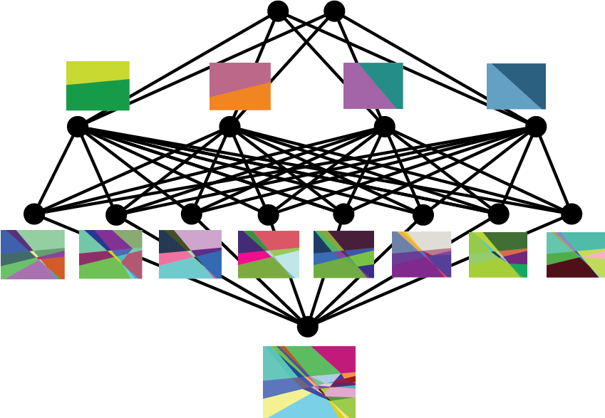
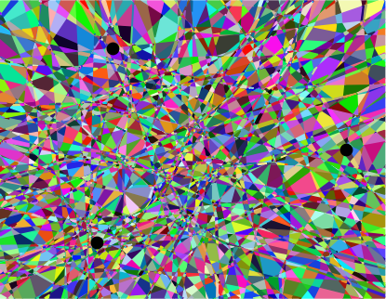
Linear regions in ReLU nets
Plane through 3 MNIST examples Depth 3, width 64 network at init
Hanin & Rolnick (2019)
Notes:
Done

Slide 5
Linear regions in ReLU nets
First moral: not nearly as many regions as expected, at least at init
The nets aren’t nearly as complex as they can be - implicit regularization?
Second moral: the # of regions decreases, then increases again, during training
Notes:
Done

Slide 6
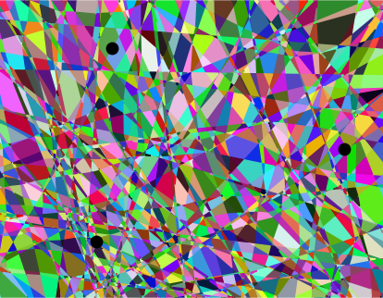
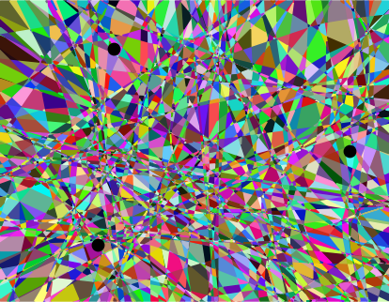
Linear regions in ReLU nets
Initialization
Epoch 1
Epoch 20
Hanin & Rolnick (2019)
Notes:
Done

Slide 7
Possible connection to generalization/memorization
Neural networks can memorize random examples
But they can also generalize
Arpit et al. (2017) saw that memorization happens after generalization
Maybe having fewer regions goes along with more generalization (simpler function)....
Notes:
Done

Slide 8
Outline for today
Neuroscience motivation for convolutional neural nets (CNN)
Definitions and intuitions
Examples of classic CNNs
Application domains
CNNs in PyTorch
Notes:
Done

Slide 9
Visual processing in the brain
Notes:
Done

Slide 10
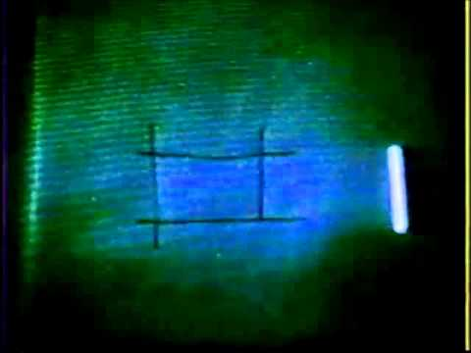
Complex cells

Slide 11
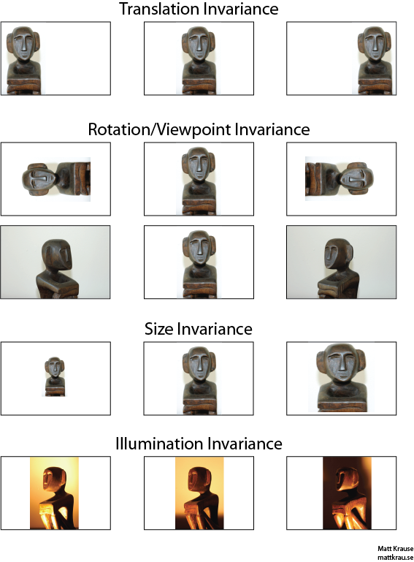
Invariances
Notes:
Done

Slide 12
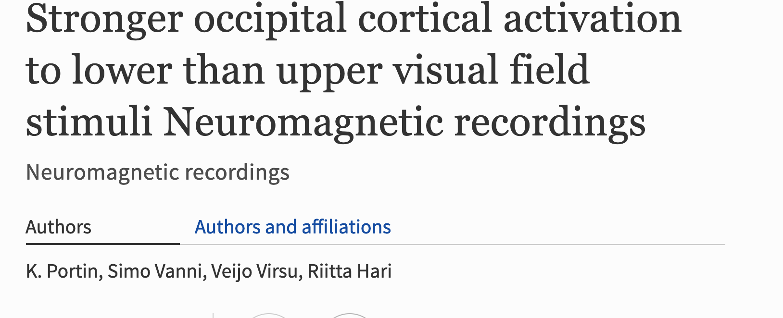
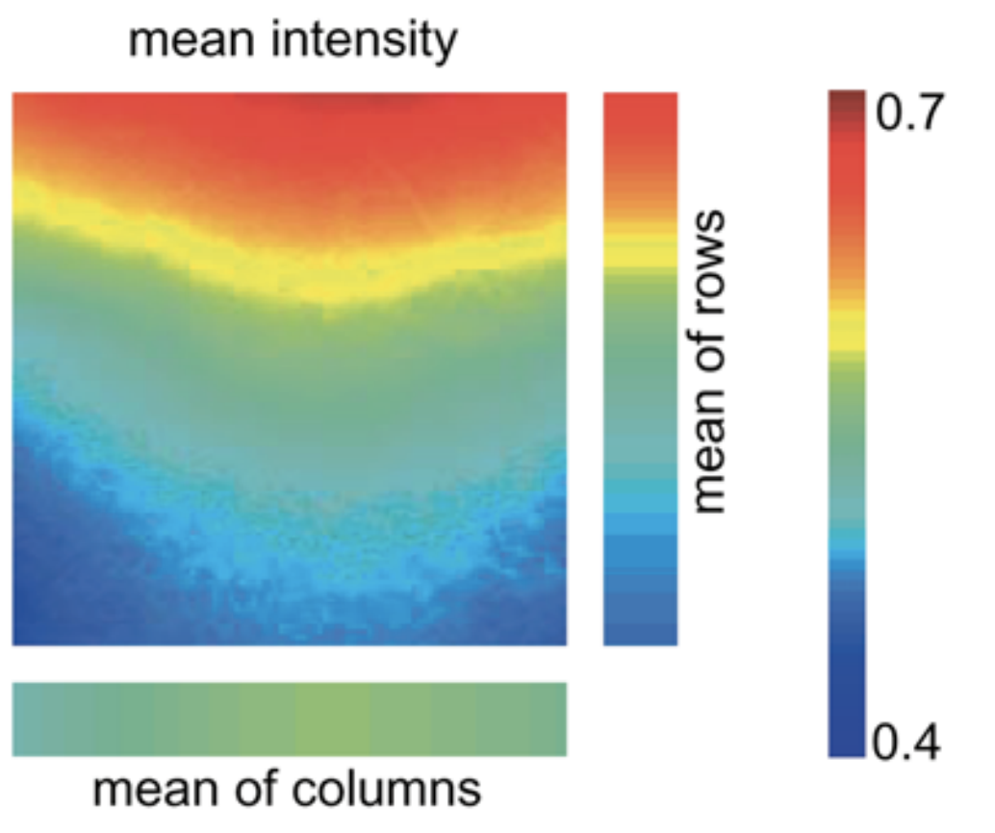
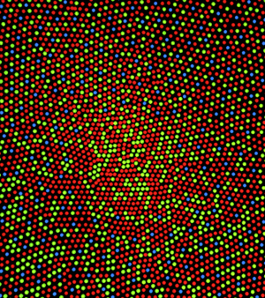
Not entirely true
Betsch et al 2004

Slide 13
Is convolution good?

Slide 14
What is a CNN?
Notes:
Done

Slide 15
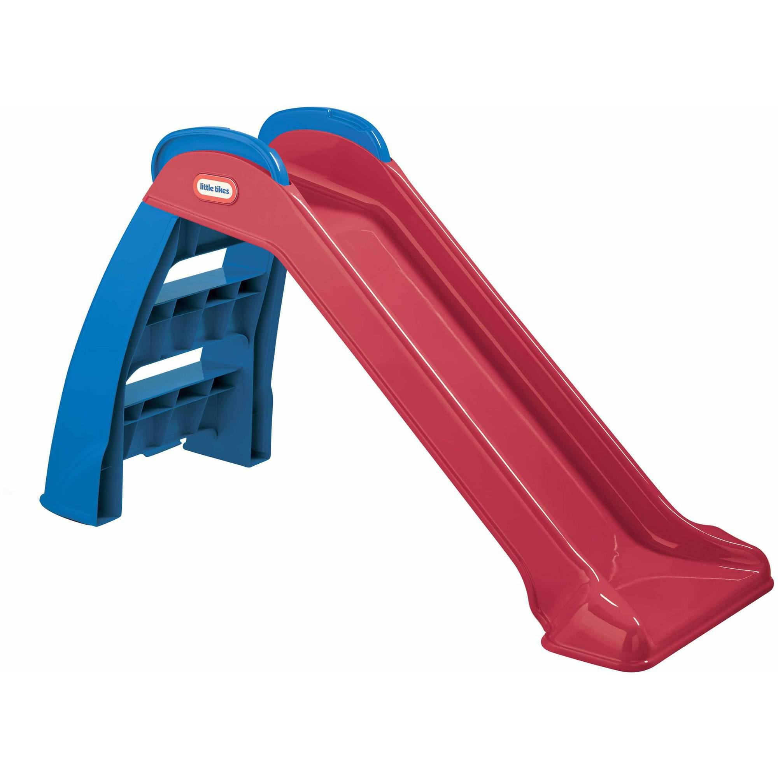
What is a convolution?

Slide 16
What is a convolution (in general)?
"In mathematics, convolution is a mathematical operation on two functions (f and g) to produce a third function that expresses how the shape of one is modified by the other. The term convolution refers to both the result function and to the process of computing it. Convolution is similar to cross-correlation." -- Wikipedia

Slide 17
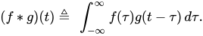
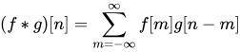
What is a convolution (in mathematics)?
Procedure to compute:
Express f, g in terms of dummy variable 𝛕
Reflect g into g(-𝛕)
Add phase t to get g(t-𝛕)
For each phase t, compute the integral of product f(𝛕)g(t-𝛕).

Slide 18
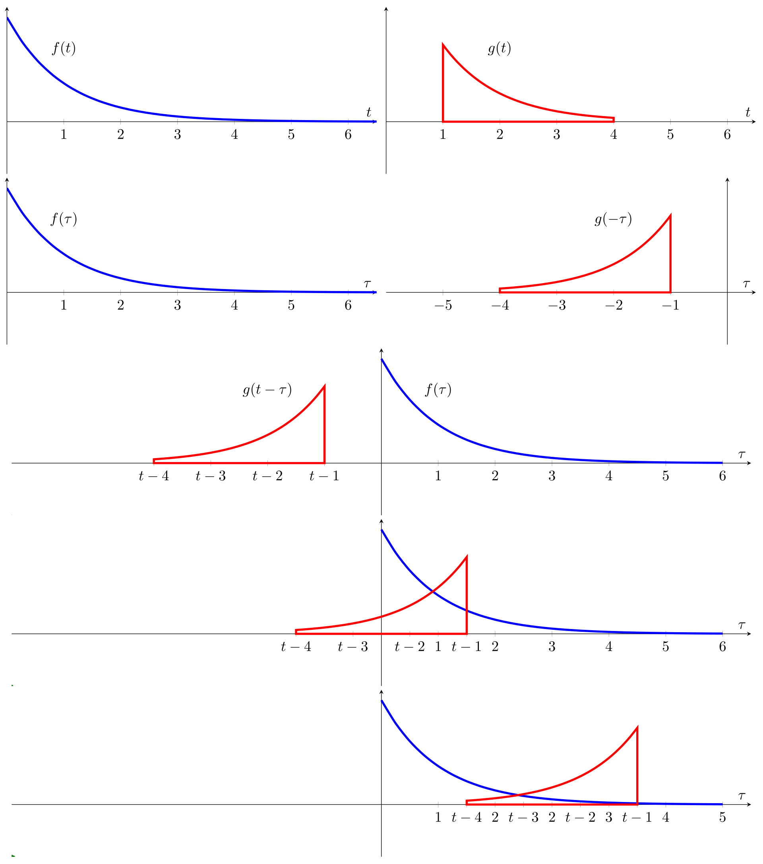

What is a convolution (in mathematics)?

Slide 19
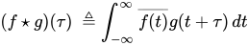
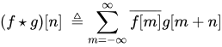
A related concept: cross-correlation.
Procedure to compute:
Express f, g in terms of dummy variable 𝛕
Take the conjugate of f.
Add phase t to get g(t+𝛕)
For each phase t, compute the integral of product f(𝛕)g(t+𝛕).

Slide 20
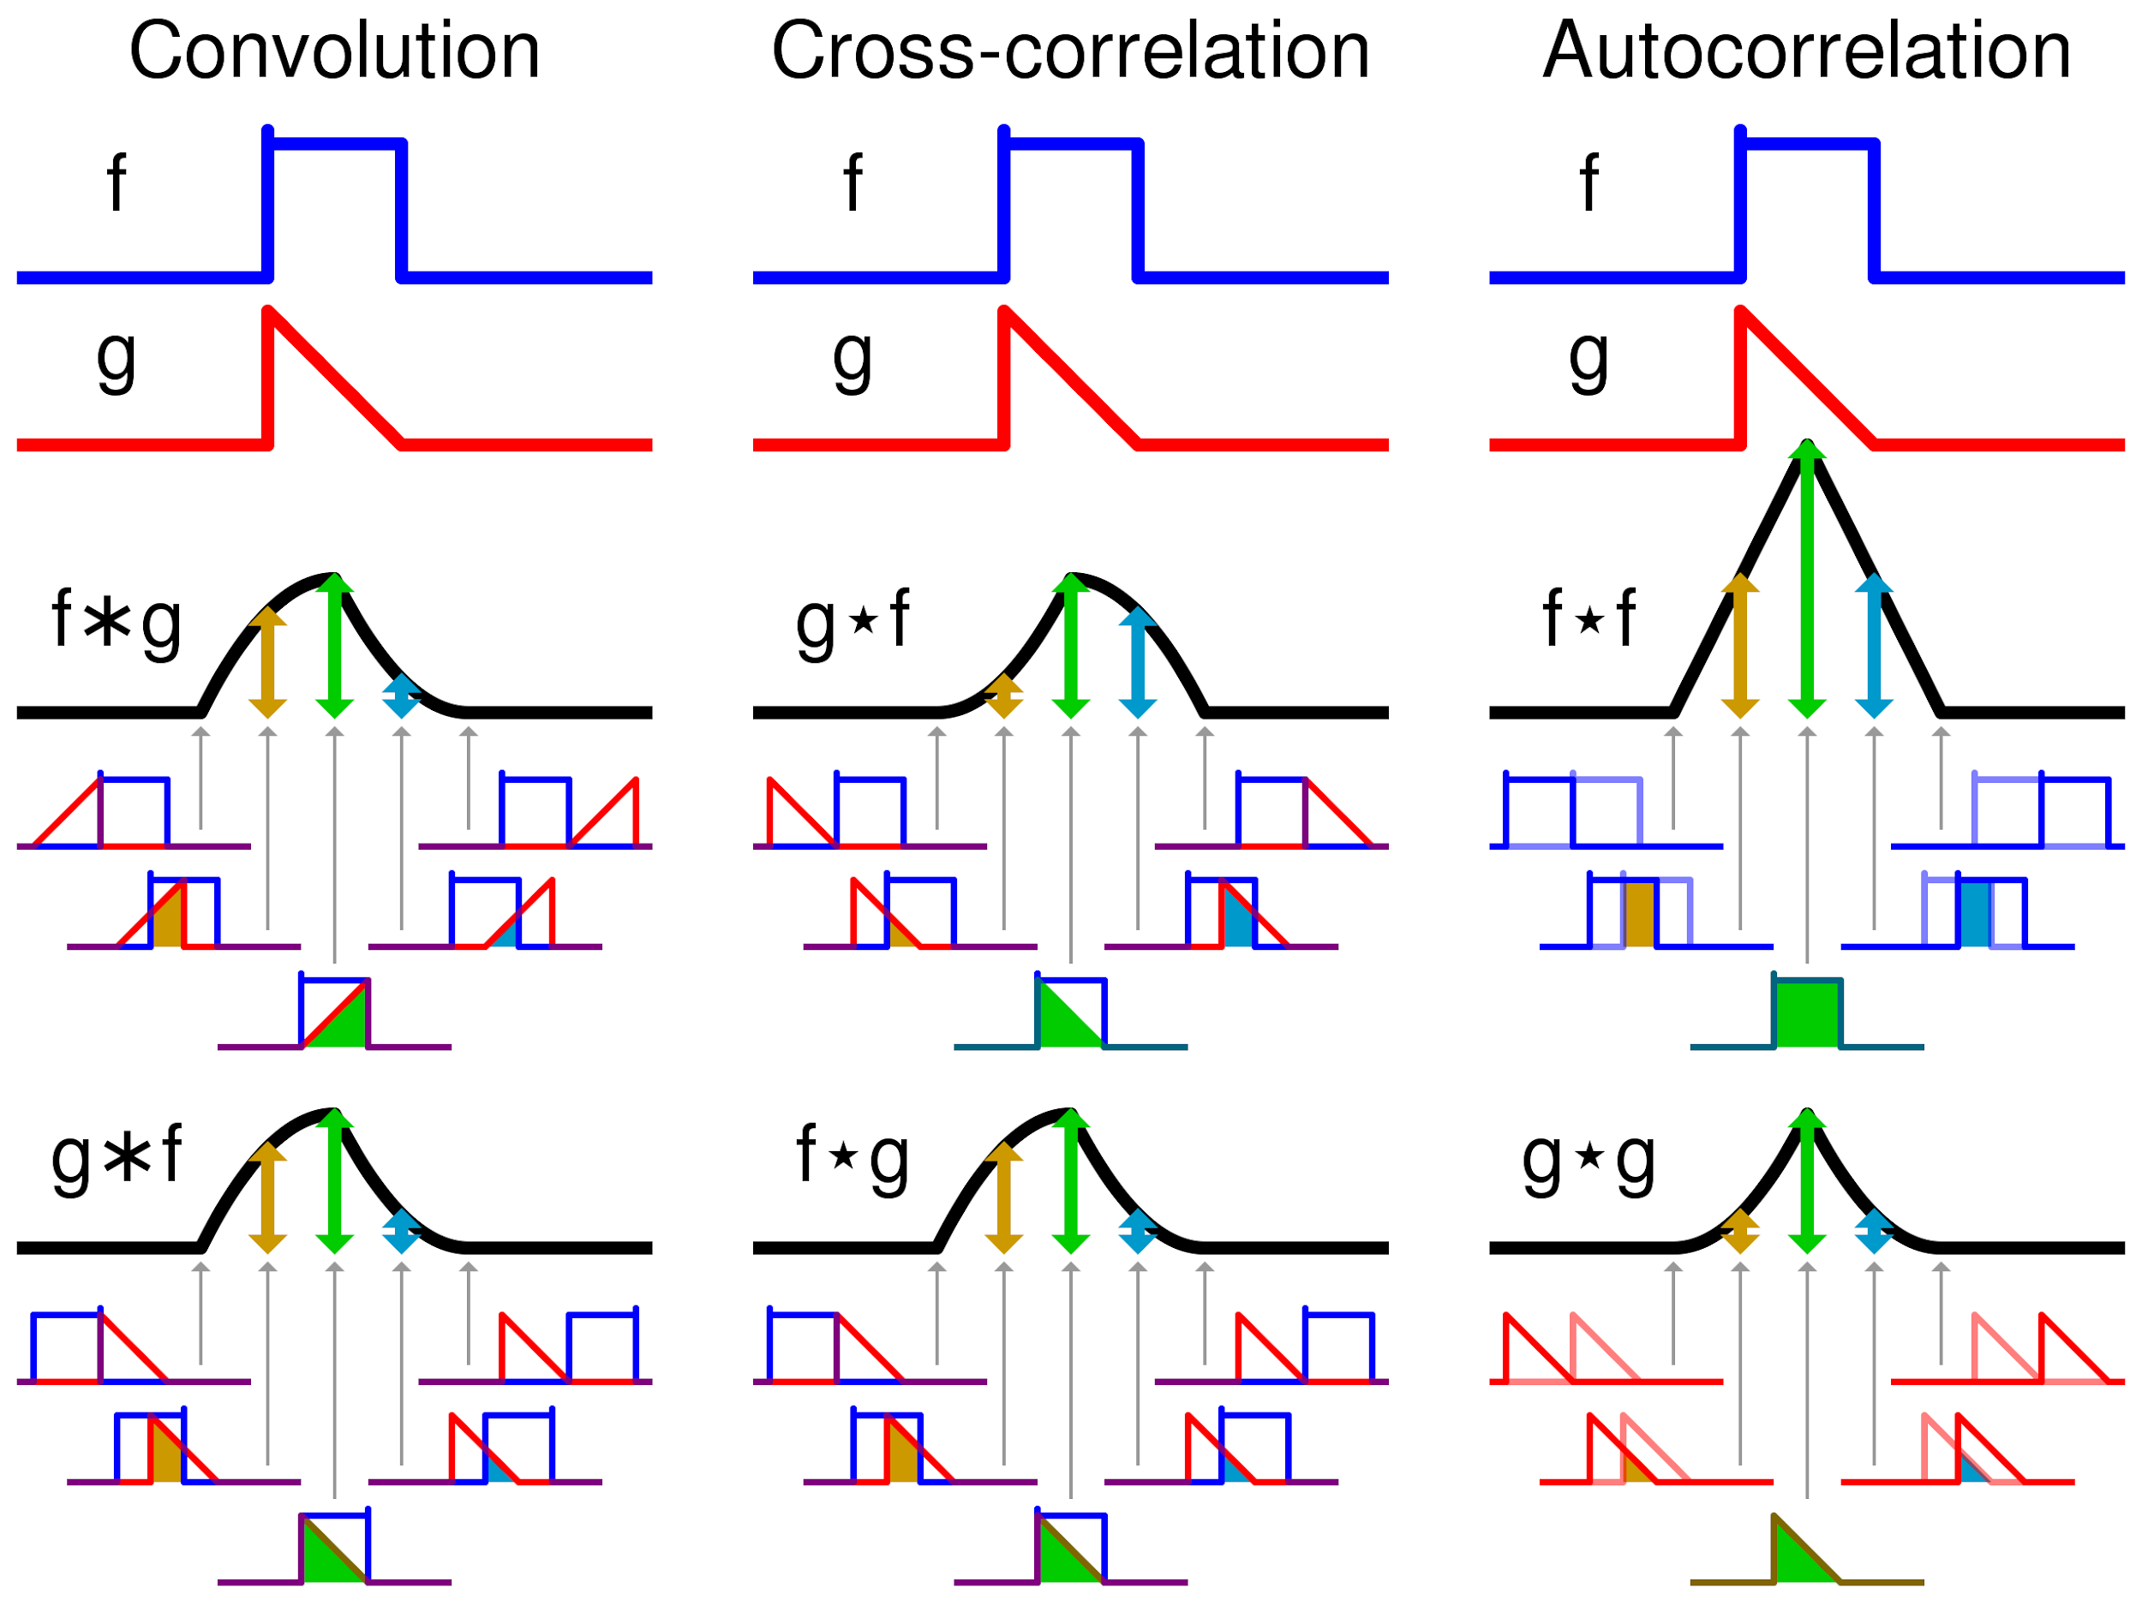
In deep learning, a "convolution" (also called a filter, neuron, or kernel) refers to a cross-correlation, not a convolution!

Slide 21
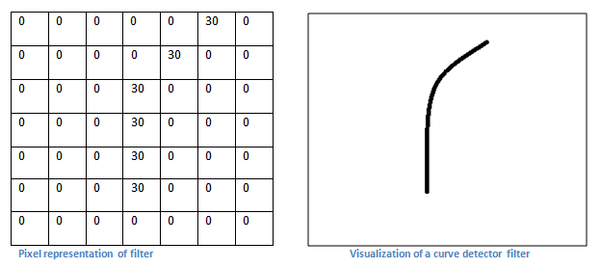
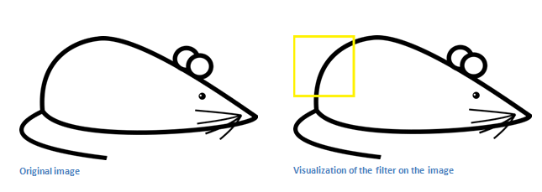
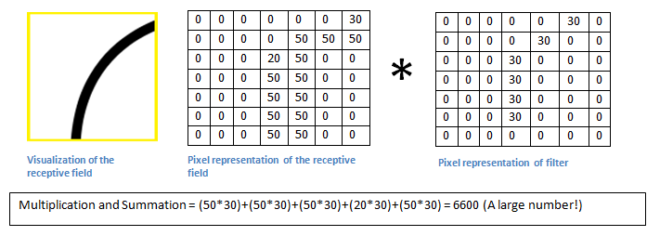
Convolutional filters: cross-correlation in 2 dimensions

Slide 22
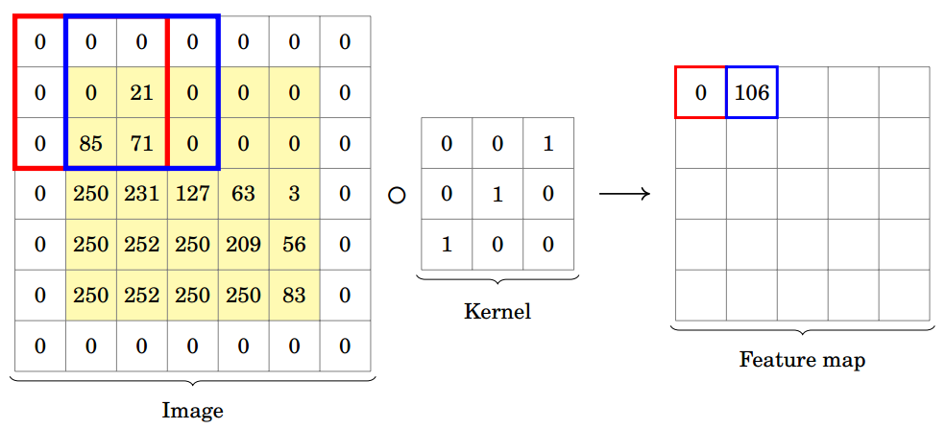

Convolutional neural networks (= CNNs = ConvNets)
Two “special layers” in a CNN: Conv and MaxPool
Convolution:
Max pooling:
Notes:
Done

Slide 23
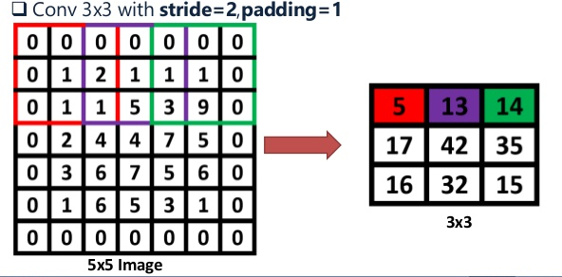
Convolution
Layers structured as matrices, not vectors
Convolution of matrices by small (e.g. 3 x 3) matrices called kernels
The kernels are the learned weights
Depending on padding and stride, image may decrease slightly in size.
Intuitively, conv layers learn how to relate neighboring pixels.
Image layers in a CNN typically have many features.
That means kernels are 4D, e.g. 3 x 3 x 16 x 32.
Notes:
Done

Slide 24
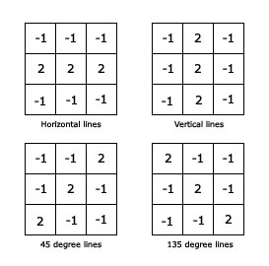
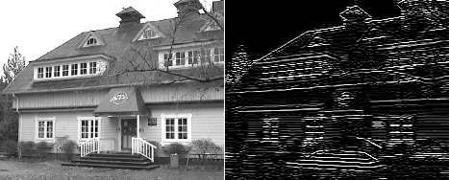
Motivation: conv for edge detection
Horizontal lines:
Notes:
Done

Slide 25
Some questions
What is convolution like with a 1x1 kernel?
Can convolution be expressed as matrix multiplication?
How does backpropagation work with a conv layer?
Notes:
Done

Slide 26
MaxPool
Intuitively, MaxPool is used because nearby pixels will give very similar output
Over the course of a network, pooling shifts layers from spatial dimensions to features
E.g.:
Conv
Pool
Conv
Pool
28 x 28 x 1 => 26 x 26 x 16 => 13 x 13 x 16 => 11 x 11 x 64 => 6 x 6 x 64 => ...
Notes:
Done

Slide 27
Why use a CNN?
Shared weights => reduced number of spatial parameters - focus on features
Computing a convolution is quick - Winograd FFT:
Fourier transform of convolution is the product of the Fourier transforms
Winograd FFT allows fast Fourier transforms
Can often be applied to any size of image with same parameters
Notes:
Done

Slide 28
Inductive biases
Deliberately less expressive models don’t overfit
Almost like Bayesian priors, but baked into the algorithm
Linear function => linear regression
Simple functions => various kinds of regularization (L1, L2)
L1 gives sparse weights
Can also just prune low-value weights and retrain (Han et al. 2015)
Rotational invariance (much less common)
e.g. Cheng et al. (2016), literally just rotate and enforce similar representations
Translational invariance => convolutional neural networks
Notes:
Done

Slide 29
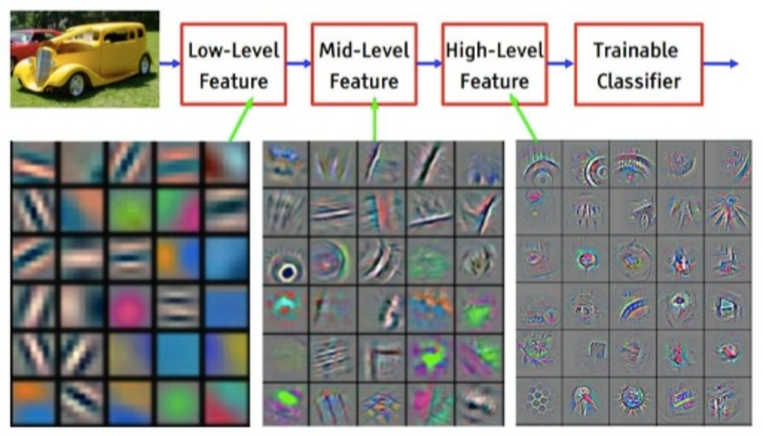
What CNNs learn
Notes:
Done

Slide 30
Visualizing neurons in a network
https://distill.pub/2017/feature-visualization/
Visualization by optimizing image to maximize activation at particular neurons/layers.
How does this work?
Notes:
Done

Slide 31
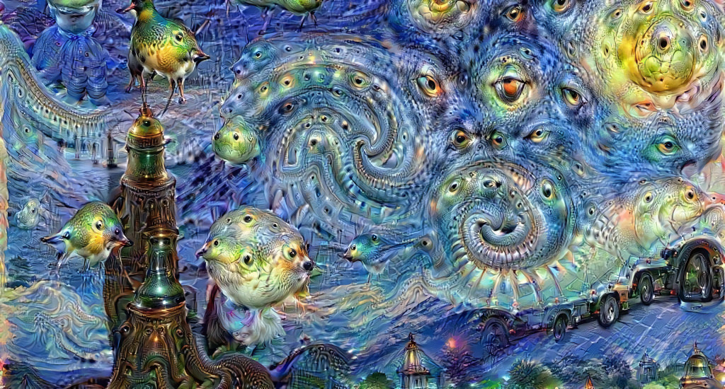
Sidenote: DeepDream
Notes:
Done

Slide 32
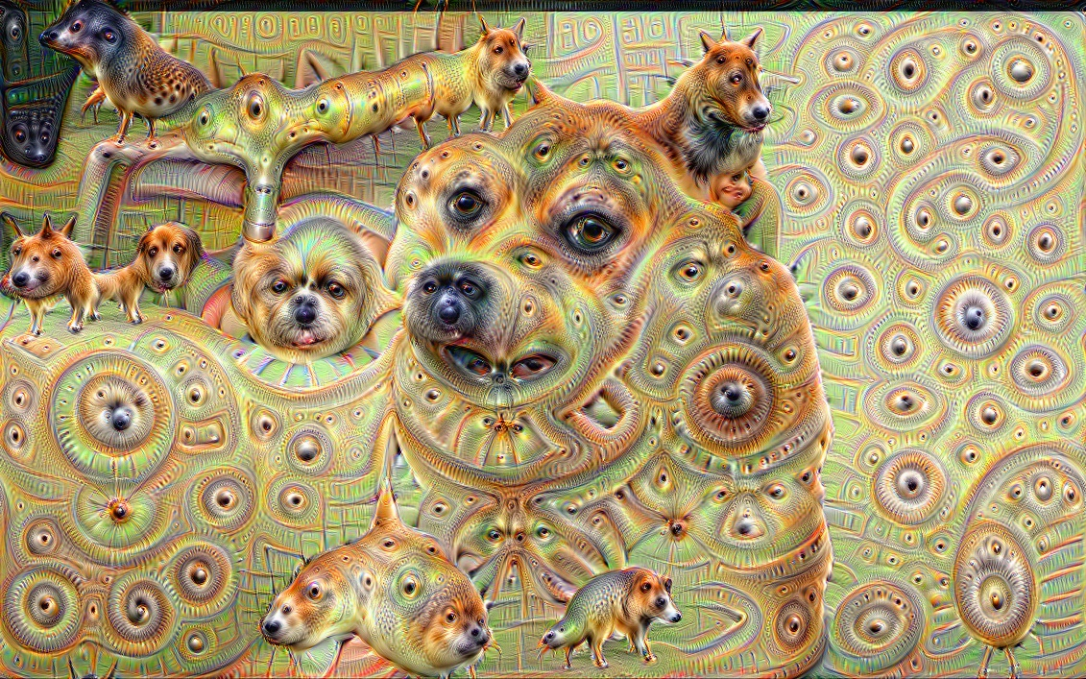
Sidenote: DeepDream
Notes:
Done

Slide 33
Some classic CNNs
Notes:
Done

Slide 34
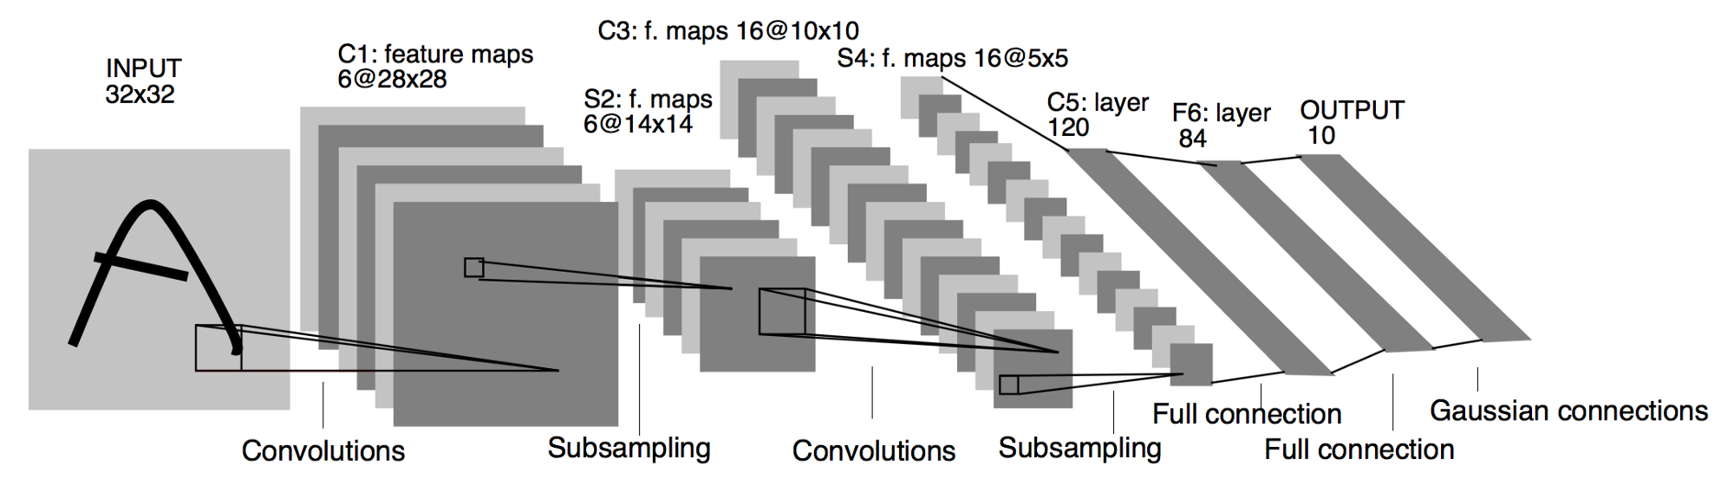
LeNet (1998)
Conv: 5x5, pooling: 2x2, tanh activation
<1% error rate on MNIST
Kernels not fully connected to all features from previous layer
Output (originally) computed similarity to ten fixed 84-dimensional vectors
60K parameters
Notes:
Done

Slide 35
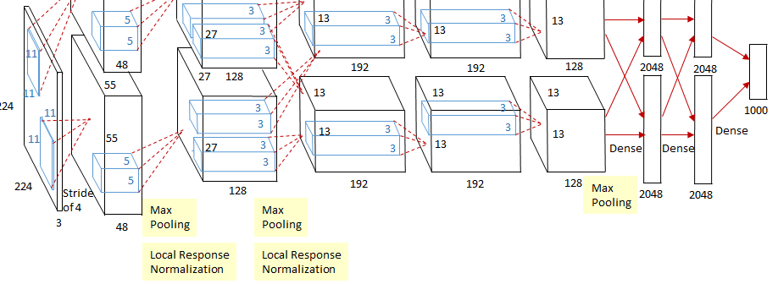
AlexNet (2012)
Popularized deep learning by huge improvement ImageNet (15.3% error vs 26.2%)
Implemented on GPU with CUDA
Conv: 11x11 (stride 4), 5x5 and 3x3, pooling: 3x3 (stride 2), ReLU w/ final softmax
Dropout (still used to prevent overfitting to small data)
Local response normalization (not very popular) - normalize activity across features
60M parameters
Notes:
Done

Slide 36
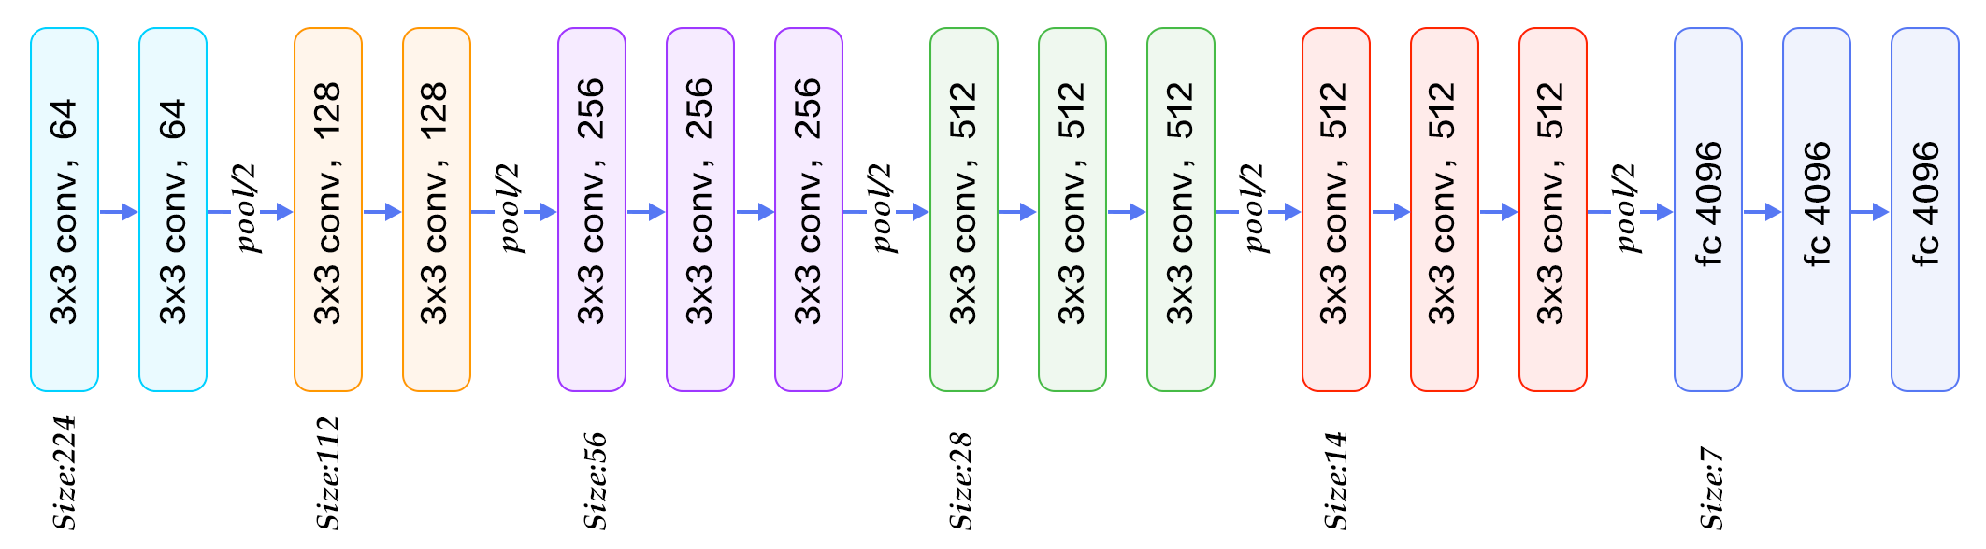
VGG (2014)
Conv: 3x3, pooling: 2x2, ReLU w/ final softmax
Quite simple
At the time, the deepest architecture
138M parameters
Notes:
Done

Slide 37
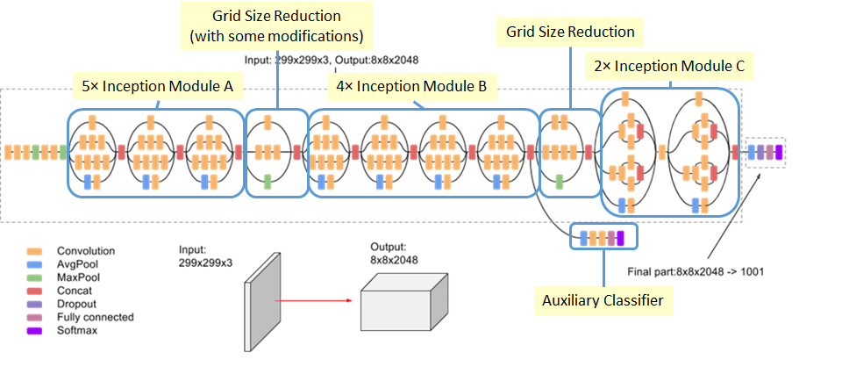
Inception(V3) (2015)
After each conv, also uses ReLU and BatchNorm (we’ll cover in 2 weeks)
Notes:
Done

Slide 38
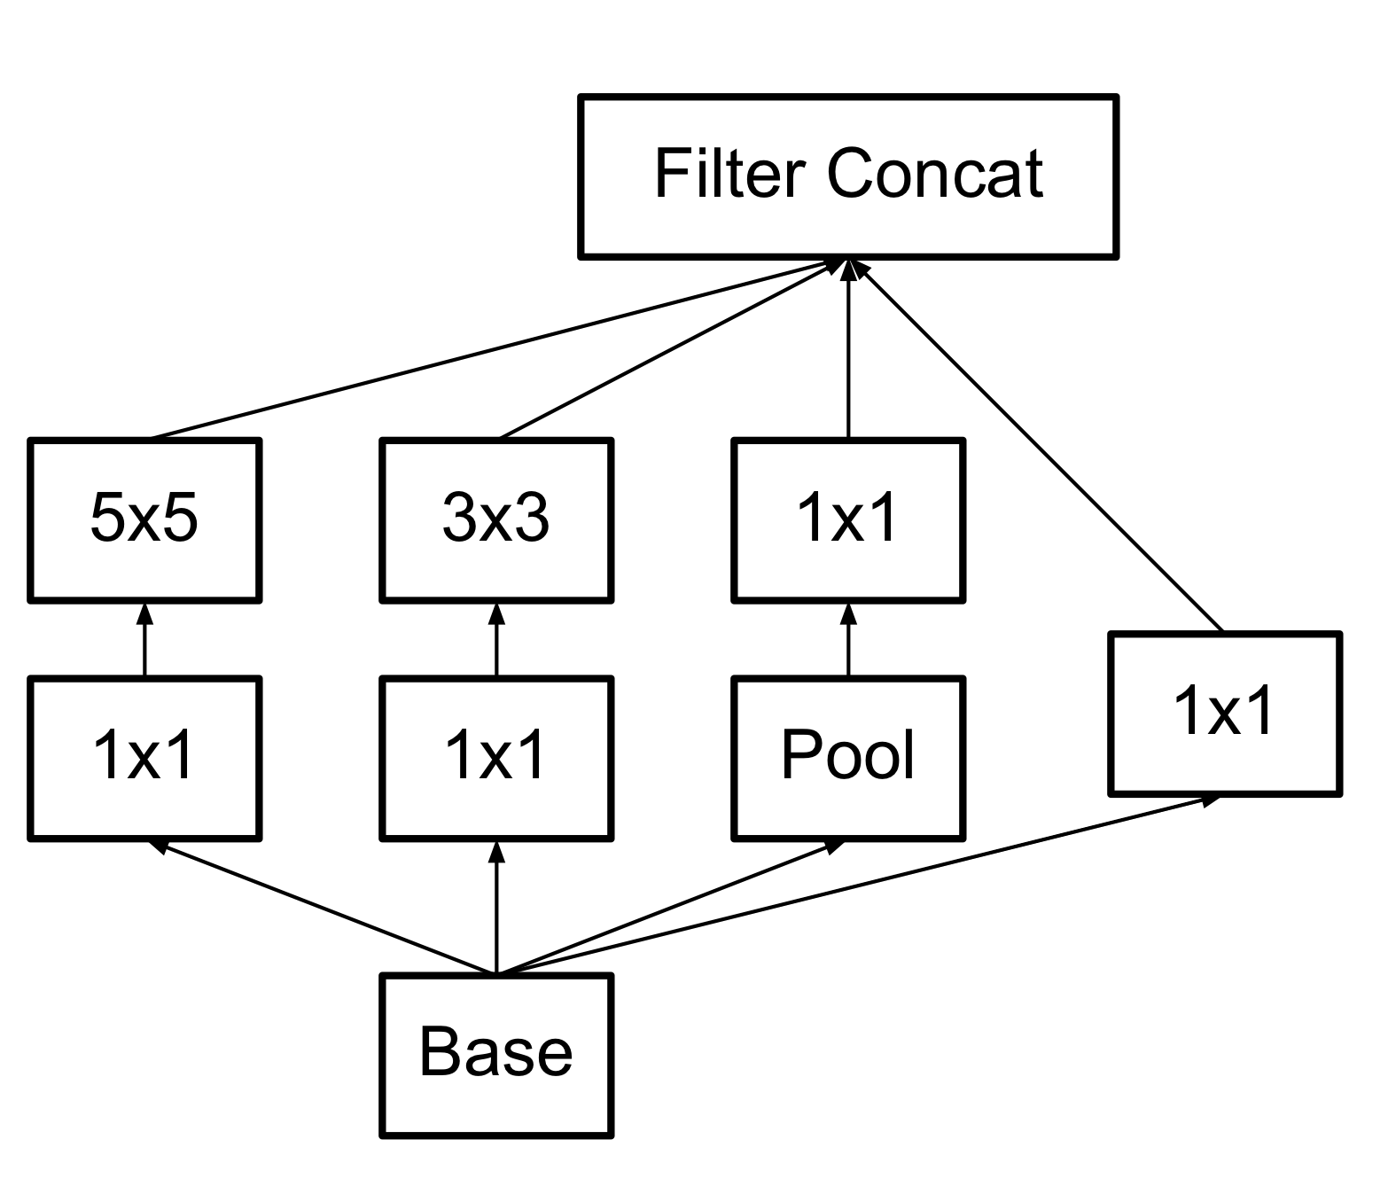
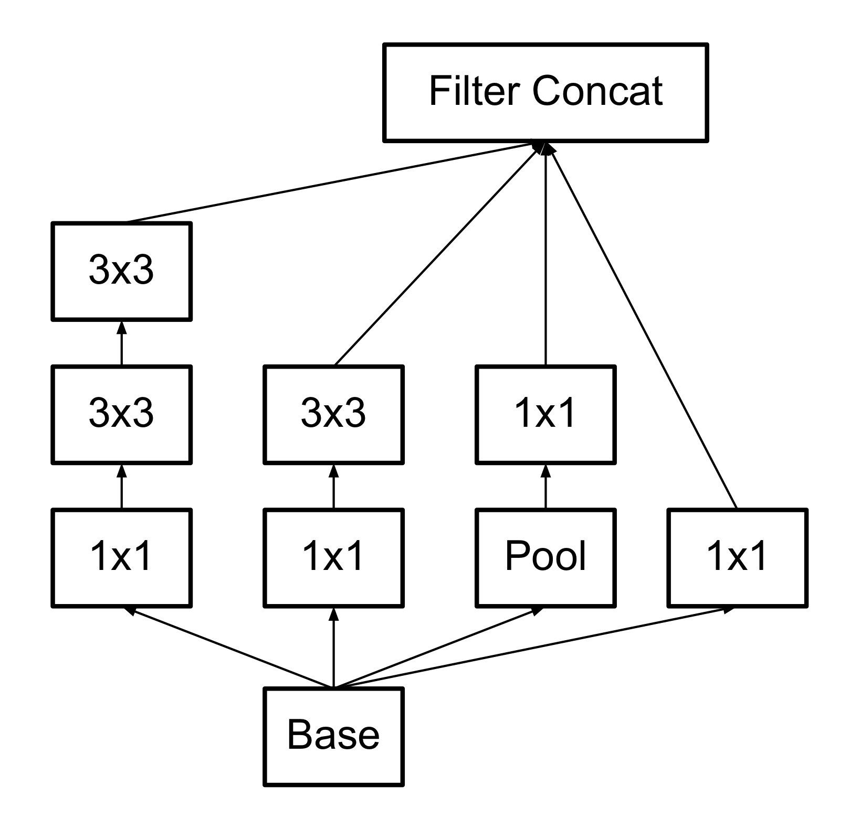
That’s pretty complicated
It’s built from simple ideas, though.
Inception module:
The point is just to include all the different possible kernel sizes.
Iterating some small kernels is similar to using a larger one:
Original
Later version
Notes:
Done

Slide 39
Why the smaller kernels?
At first, people thought large kernels were good.
After all, small ones are a special case.
And large kernels include longer distance info.
But, several small ones in series can have a similar impact.
It’s cheaper - both in parameters and in computation time.
Now, people mostly use 3x3 (or 1x1).
Notes:
Done

Slide 40
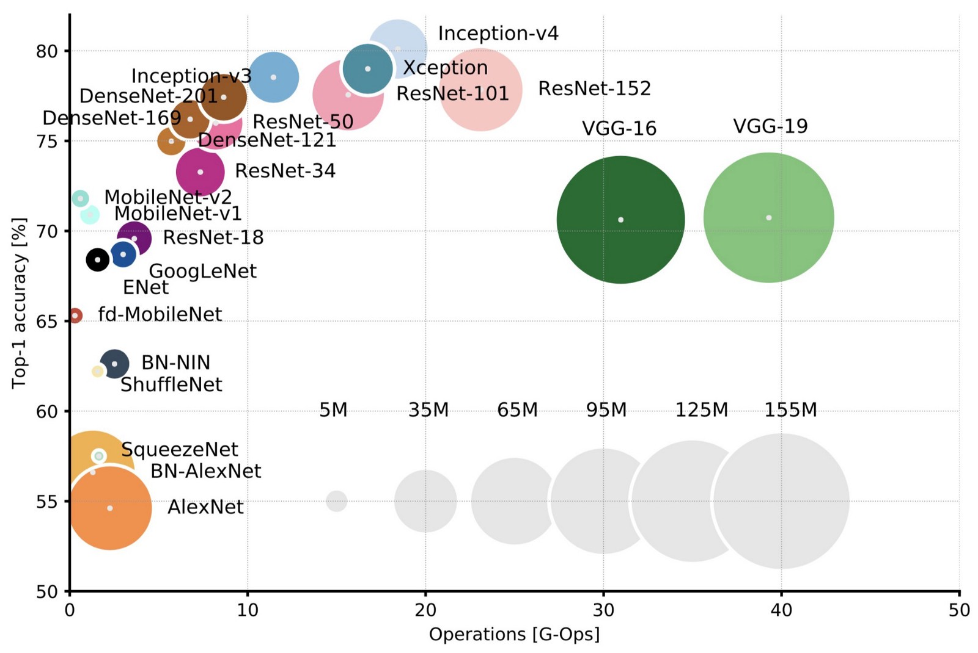
Performance of convolutional architectures on ImageNet
Notes:
https://arxiv.org/pdf/1605.07678.pdf

Slide 41
Applications of CNNs
Notes:
Done

Slide 42

Image recognition
Cornell Lab of Ornithology, Merlin bird identification app (see Van Horn et al. 2015)
Notes:
Done

Slide 43
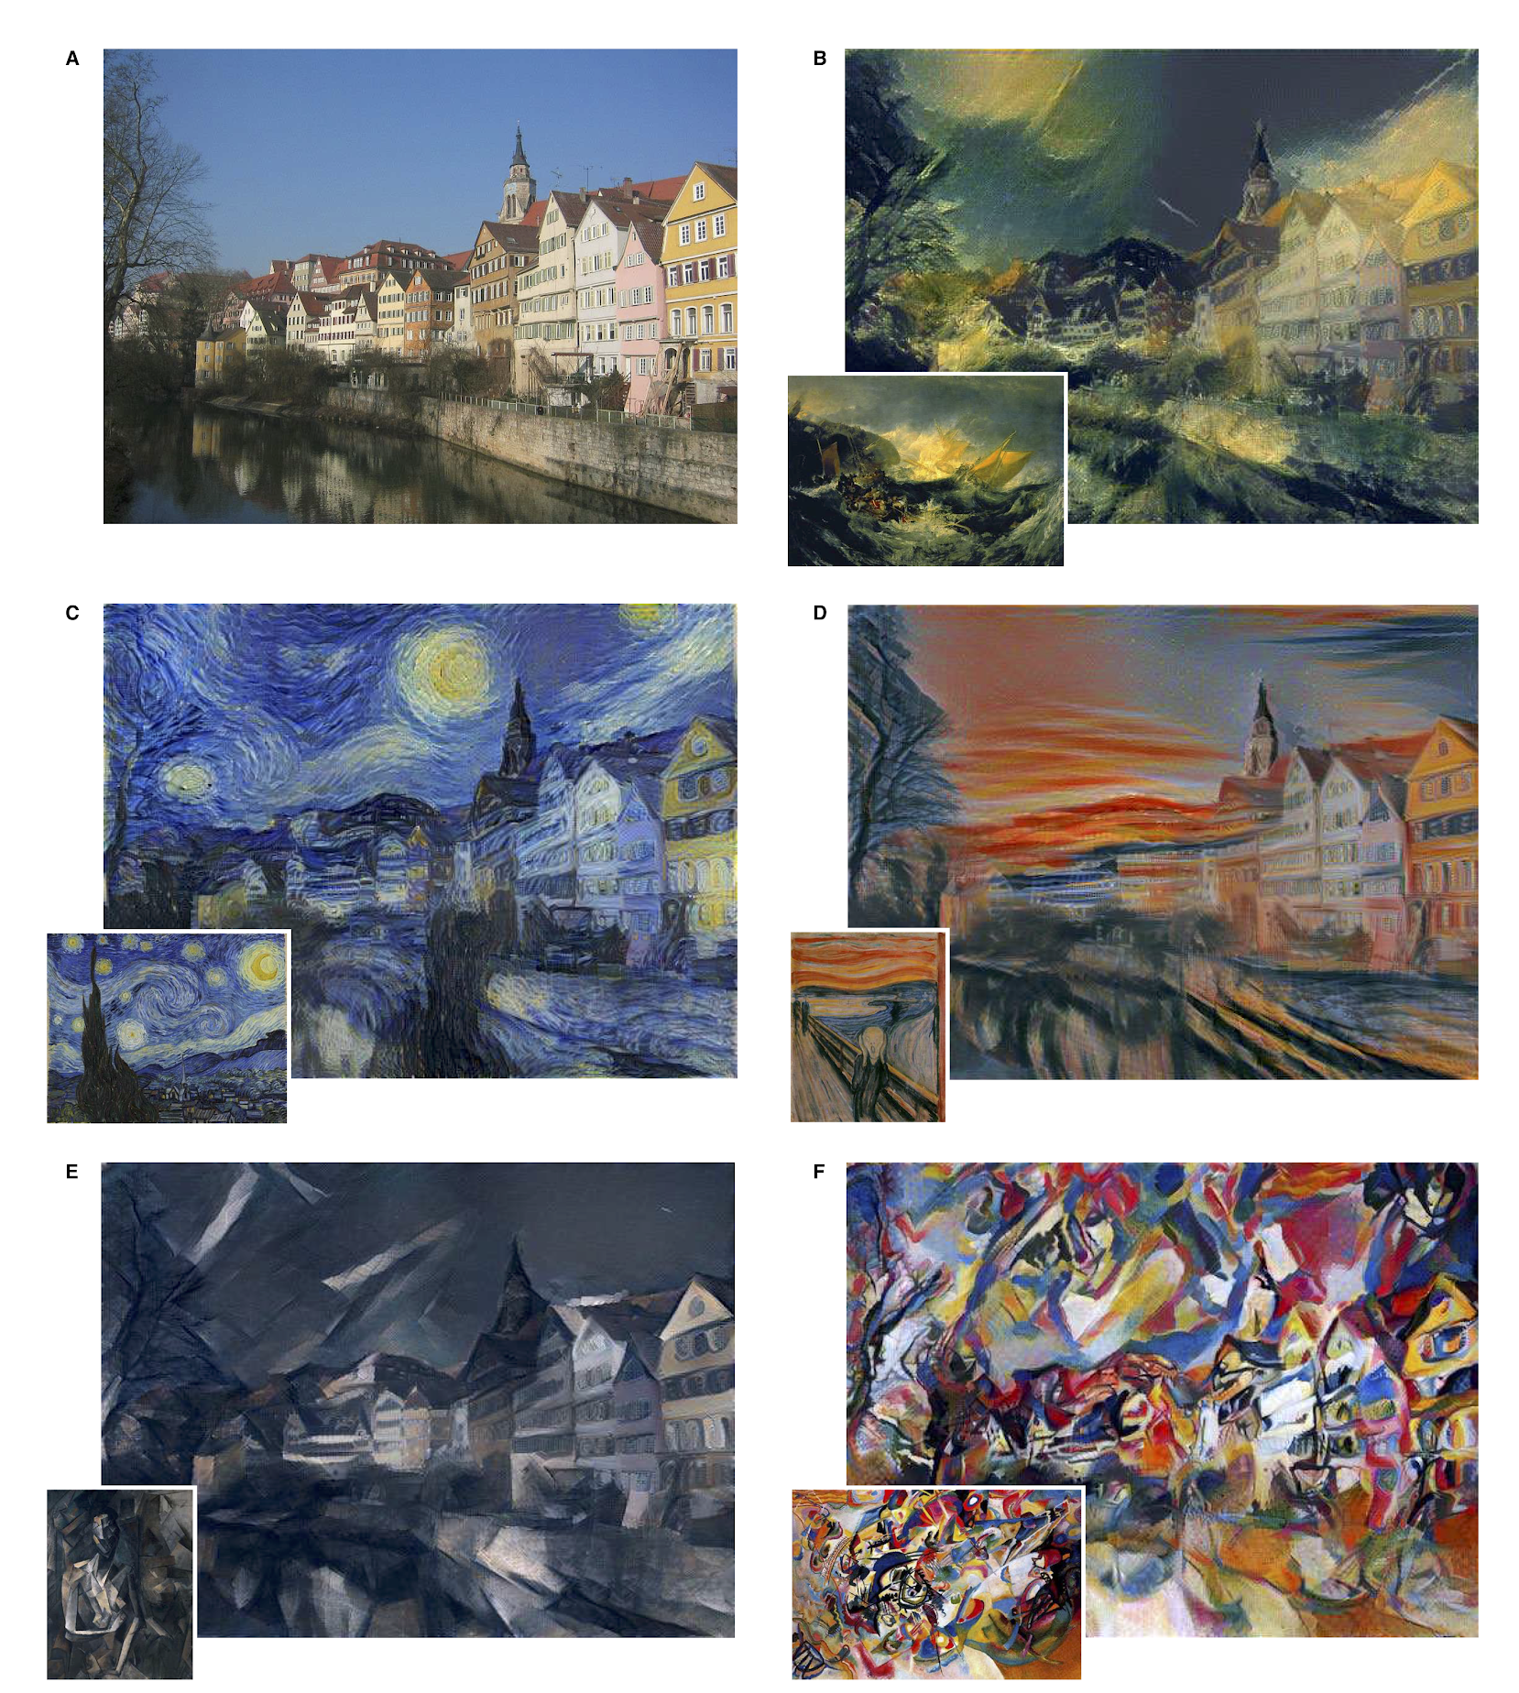
Style transfer
Gatys et al. (2016)
Content is measured by deeper layers.
Style is measured by the correlations between feature vectors at lower layers.
Objective 1: Minimize content difference between new image and content template.
Objective 2: Minimize style difference between new image and style template.
Notes:
Done

Slide 44

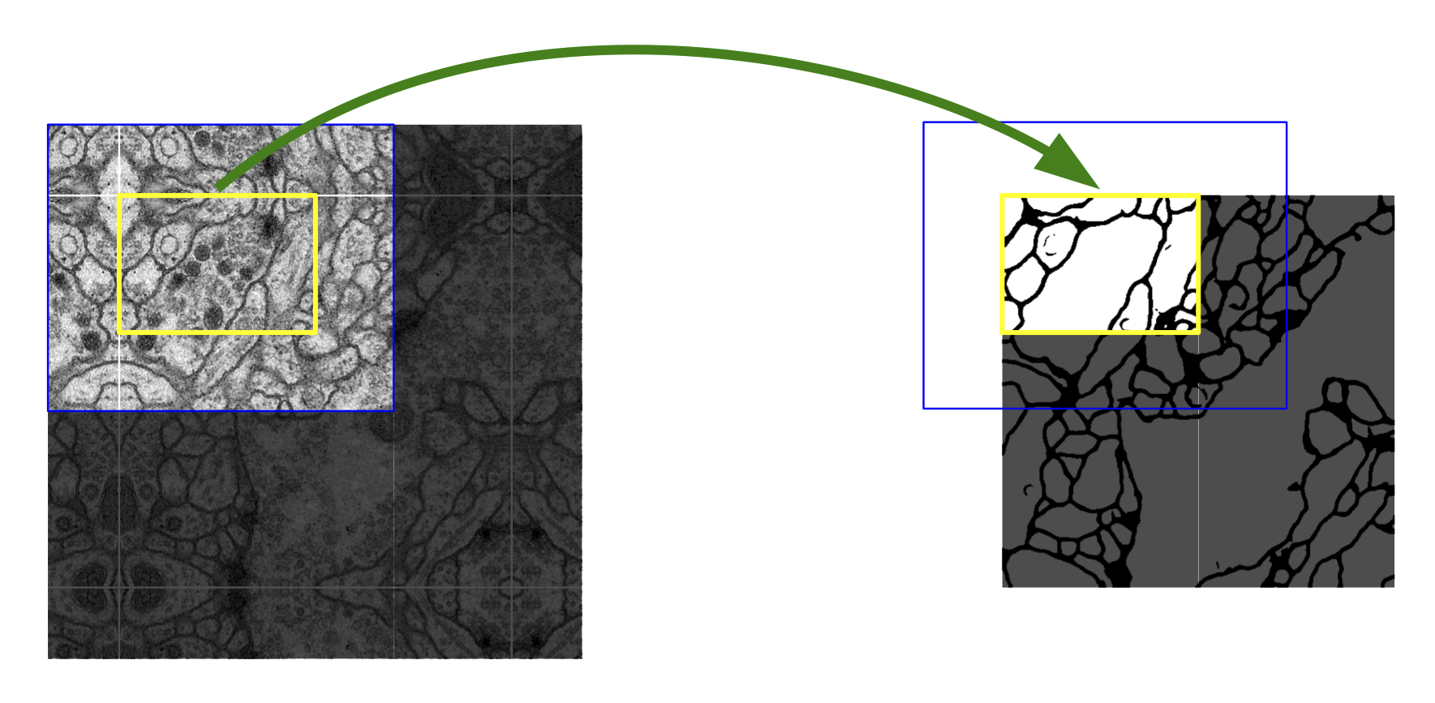
Image segmentation
U-Net (Ronneberger et al. 2015)
Segmenting biological cell membranes
Notes:
Done

Slide 45
Insights of U-Net
“Up-convolution”
Fixes the problem of shrinking images with CNNs
One example of how to make “fully convolutional” nets: pixels to pixels
“Up-convolution” is just upsampling, then convolution
Allows for refinement of the upsample by learned weights
Goes along with decreasing the number of feature channels
Not the same as “de-convolution”.
Connections across the “U” in the architecture

Slide 46
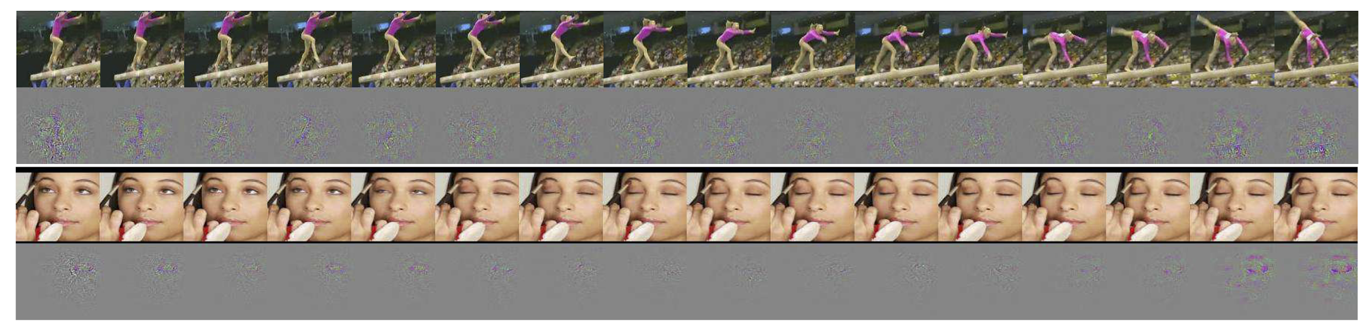
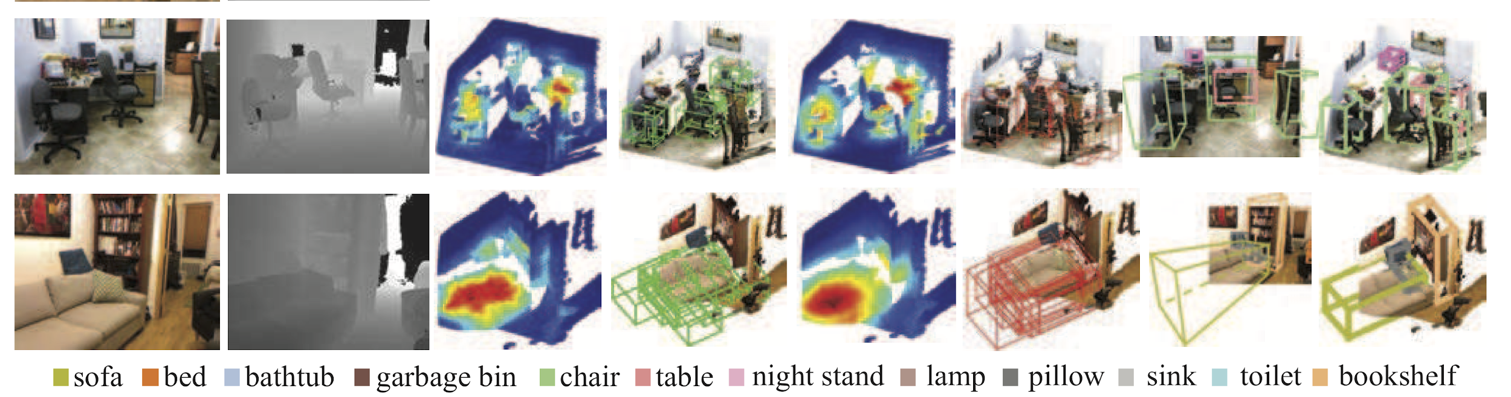
3D convolution
Motion in videos - Tran et al. (2015)
Objects from images w/ depths - Song & Xiao (2016)
Notes:
Done

Slide 47
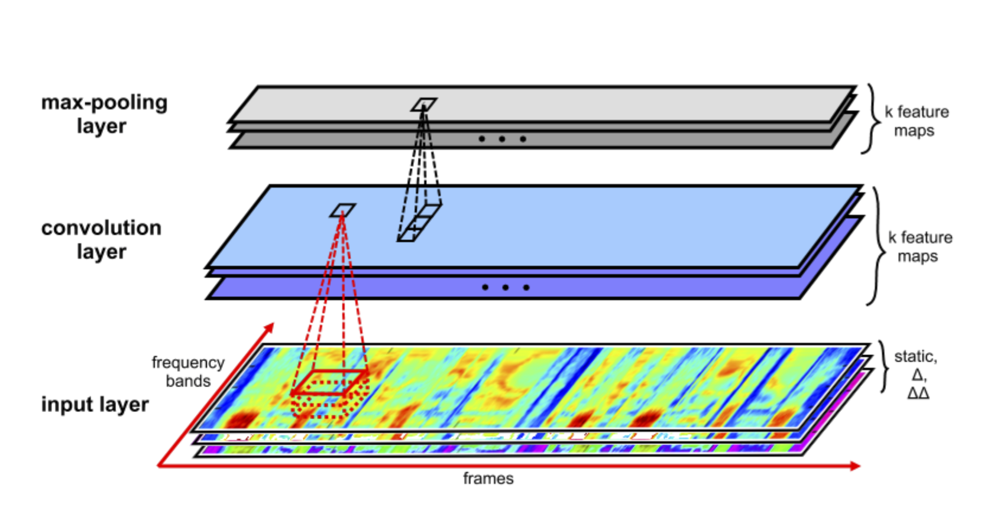
Speech recognition
Zhang et al. 2017
CNN competitive with RNNs (e.g. LSTMs)
10 layers, 3x5 conv, 3x1 pooling - deep enough for temporal dependencies
TIMIT task, classifying phonemes
Notes:
Done

Slide 48
Graph convolution
For a full intro: https://tkipf.github.io/graph-convolutional-networks/
Basic idea:
A convolution for matrices is a “local” combination of entries in the matrix
Can do the same thing for a graph
Here, “local” is whatever nodes a node is adjacent to
Just the tip of an iceberg…
Used in learning stuff about molecules, citations, social networks, etc.
Notes:
Done

Slide 49
CNNs in PyTorch
Notes:
Done

Slide 50
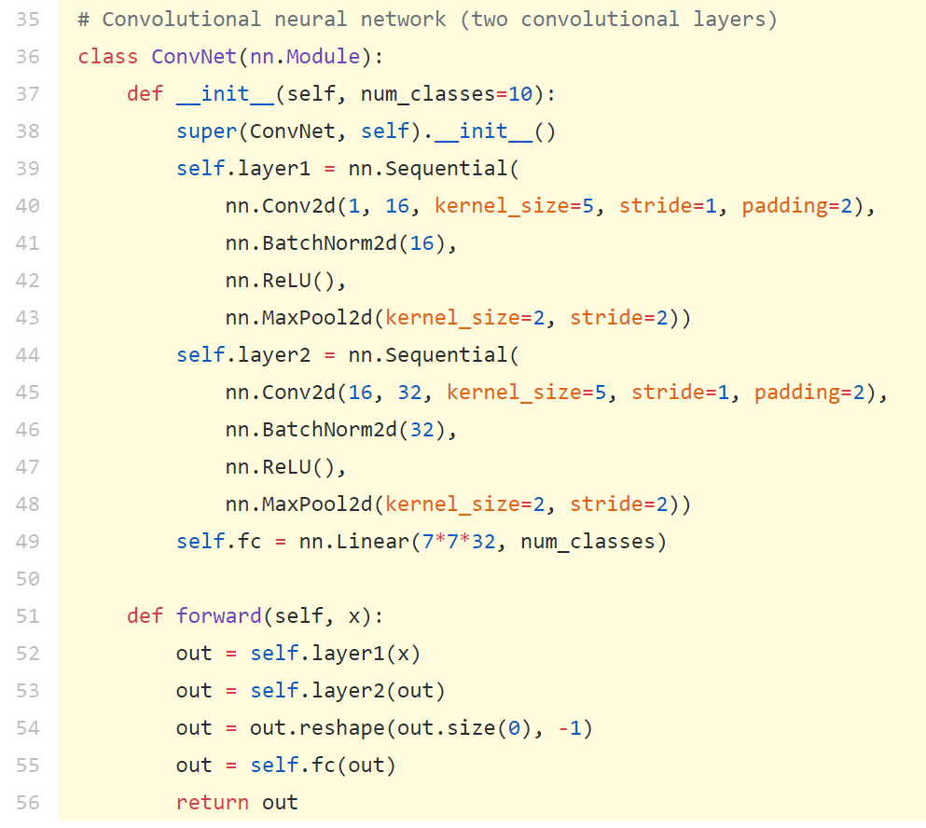
Defining a CNN in PyTorch
https://pytorch.org/docs/stable/nn.html#convolution-functions
Notes:
https://pytorch.org/docs/stable/nn.html#convolution-functions

